Slide 1

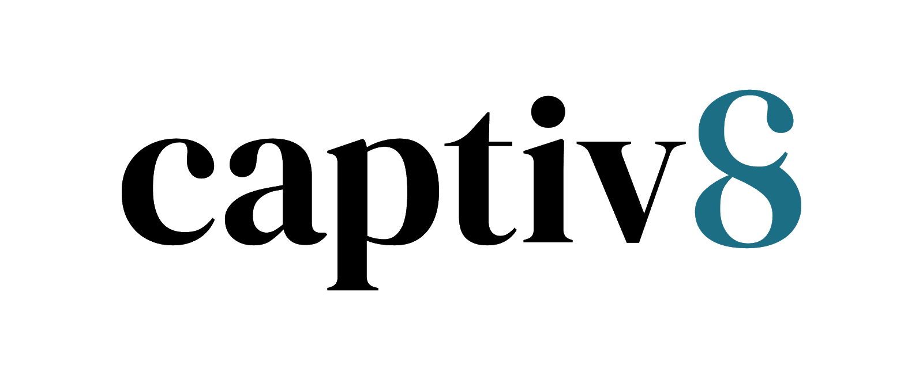

+
Influencers at X4: The Experience Management Summit
February 2023

Slide 2

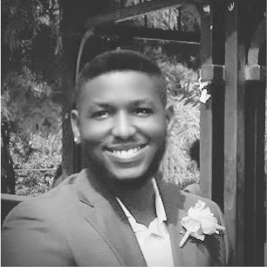
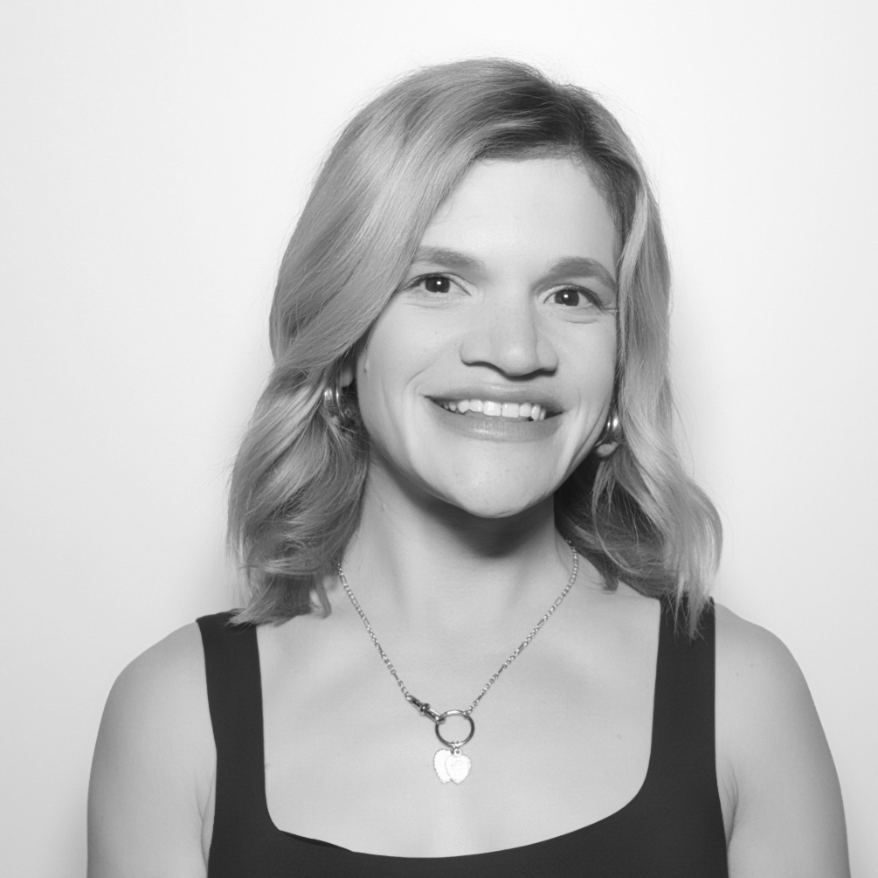
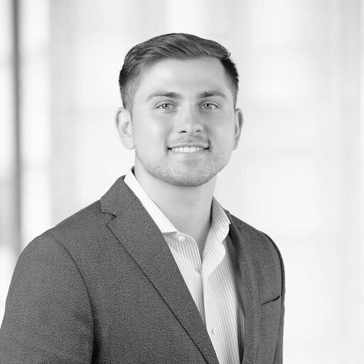
Your Captiv8
TEAM
Terrence Strickland
Holland Mervis
We’re your full-service dedicated Qualtrics team, our goal is to uplevel your brand activations to help your business succeed - leveraging our first-party, industry, audience, and technology every step of the way.
Sr. Customer Service Success Manager
Strategic Partnerships Lead
Bobby Solecki
Sr. Account Manager

Slide 3

We combine data intelligence & trusted storytellers to drive impactful results.
2015
Since founding 2015, Captiv8 has run over 25,000 campaigns. That’s a lot of content, creators, and invaluable experience.
250+
Employees Globally, a diverse powerhouse team of influencer experts. 70% of our team are BIPOC.
30M+
Creators globally & the largest database of authenticated creators
200+
Customers including enterprise brands, advertising agencies, and SMB. 40% of the Fortune Top 20 are Captiv8 Customers.
✩✩✩✩✩
5 Star Rating on G2 by Customers, ranked #1 for Enterprise Influencer Solutions
Integrated with API partnerships across the social spectrum, including TikTok.
Data-First
Enterprise-Grade
Ai-Driven
Winner of “Best Influencer Marketing Platform”
Notes:
Saeyoung

Slide 4
What’s Inside?
PAGE 05
Campaign Strategy
PAGE 08
Talent + Messaging Approach
PAGE 11
Talent Selection Process
PAGE 14
Paid Media
PAGE 16
Tips for and On-Site Event
PAGE 19
Measurement

Slide 5

Campaign Strategy
Notes:
Sae

Slide 6

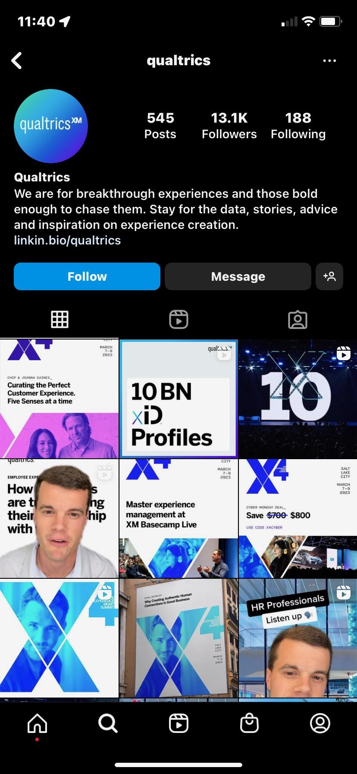
What We Heard
OBJECTIVE
Increase awareness and drive event attendance + traffic
to the Qualtrics website.
THE TARGET AUDIENCE
Tech-centric executives + decision makers
FLIGHTING + APPROACH:
Pre-event (Pre-Feb 20) Drive event registrations
Onsite (March 7-9): Brand awareness push
INVESTMENT
$10,000
KPIs
Awareness + Site Traffic
EVENT DATE
March 7-9, 2023
EVENT LOCATION
Salt Lake City
Notes:
Chris

Slide 7
Our Approach
Recommended Platform
Partner with known and trusted business professionals to drive buzz + registrations for the the X4 Summit.
Creators will speak to their audiences about the amazing opportunity to attend the summit and be part of something unforgettable!
Content created can be syndicated to LinkedIn to further spread awareness.
We recommend utilizing Instagram and TikTok to generate awareness from the core Qualtrics audiences. The heavy use of Instagram stories can generate immediate action from audiences to visit the Qualtrics landing page & register to attend the event. In-feed videos can be used to continuously generate awareness of Qualtrics by serving as evergreen content.
Tier of Influence
Based on the investment level, we suggest a mix of mid-to-lower tiered creators to maximize reach across multiple audiences.
Follower Breakout
Nano: <10k
Micro: 10k-100k
Talent Type
Established business professionals who are able to influence their organizations and move buying power.
Notes:
Laura

Slide 8
Talent + Messaging Approach
Notes:
Sae

Slide 9
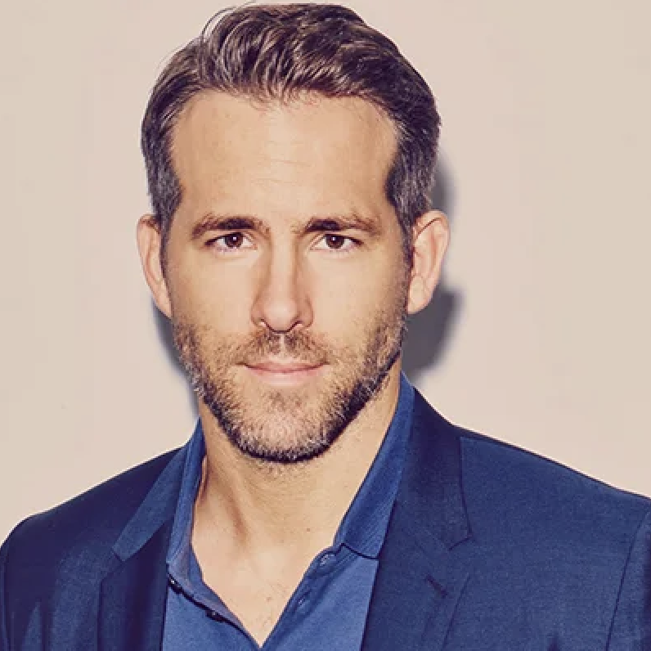
Creative Messaging
“A mix of creators will
spread the word that Qualtrics will be hosting a can’t miss 3-day management in tech event. They will highlight the excitement around the event with the goal to get audiences to attend all while driving webpage views & audience education of what Qualtrics has to offer!
10 keynotes, 10k attendees, 100 breakouts - Celebrity Speakers!

Slide 10

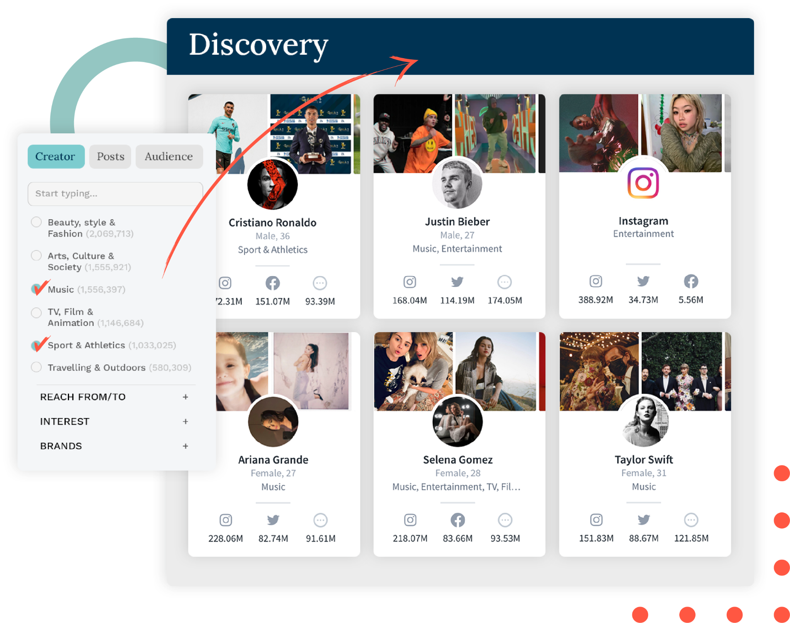


Finding Qualtrics Talent
THE ART:
We recommend the following
talent attributes for the best performance:
THE SCIENCE:
Our platform aggregates key metrics from each influencer through APIs and machine learning to provide a target selection based on KPIs & audience fit
BUSINESS PROFESSIONALS: Historically top-performing content comes from reliable leaders of key interests, driving stronger performance results.
PRODUCT AFFINITY: Content tends to drive more action when the talent authentically loves the category + brand mission. Who is already talking about Qualtrics?
LOWER TIERS: Top-performers in terms of engagement + driving sign up/clicks are those with a lower following, as they have a more engaged audience.

Slide 11
Talent Selection Process
Notes:
Sae

Slide 12
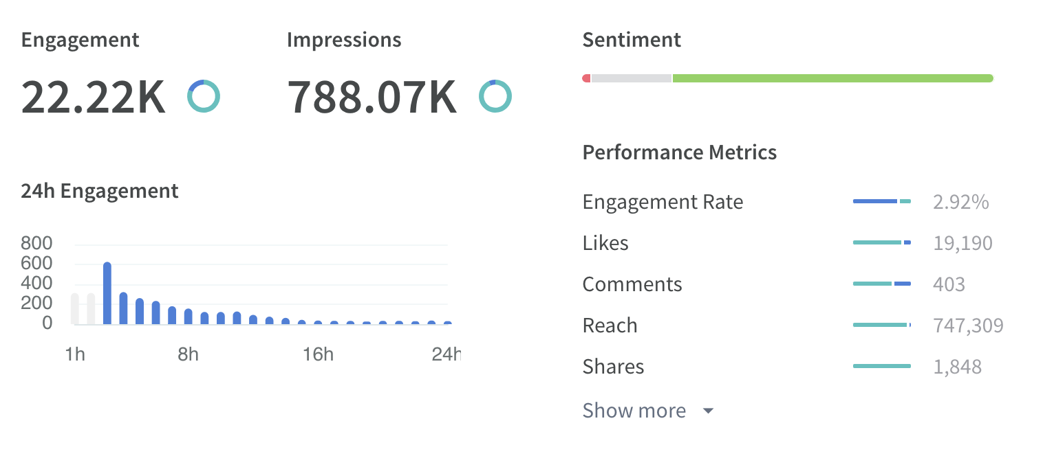
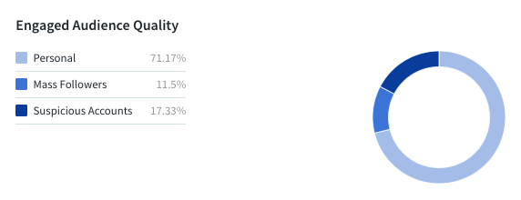
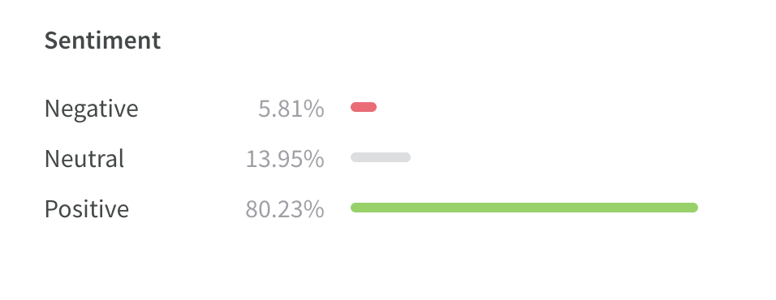
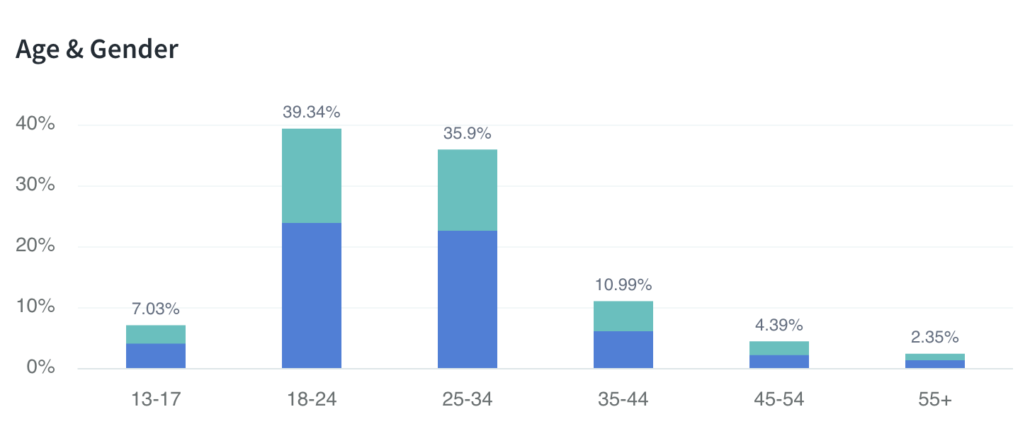
Talent Selection Process
ENGAGEMENT QUALITY
AUDIENCE
QUALITY
*no talent are recommended with over 20% of their audience under suspicious accounts
Captiv8’s platform aggregates key metrics from each creator through API integration + Machine Learning to help narrow down creator selection to best fit each campaigns KPIs + target audience.
AUDIENCE DEMO, LOCATION + ETHNICITY

Slide 13
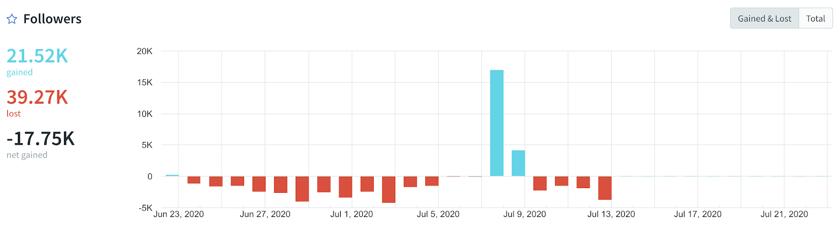
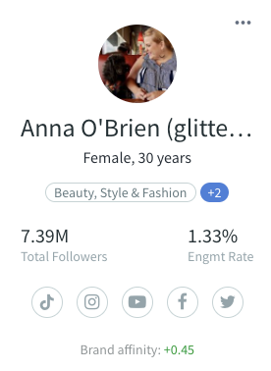
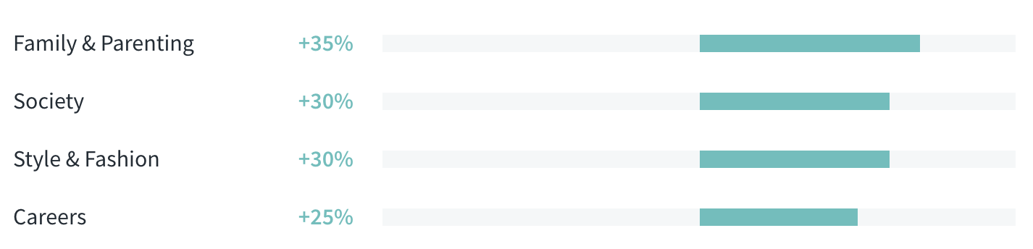
Talent Selection Process
VELOCITY
BRAND
RELEVANCE
Captiv8’s platform aggregates key metrics from each creator through API integration + Machine Learning to help narrow down creator selection to best fit each campaigns KPIs + target audience.
CONTEXTUAL RELEVANCE

Slide 14
Paid Media
Notes:
Sae

Slide 15
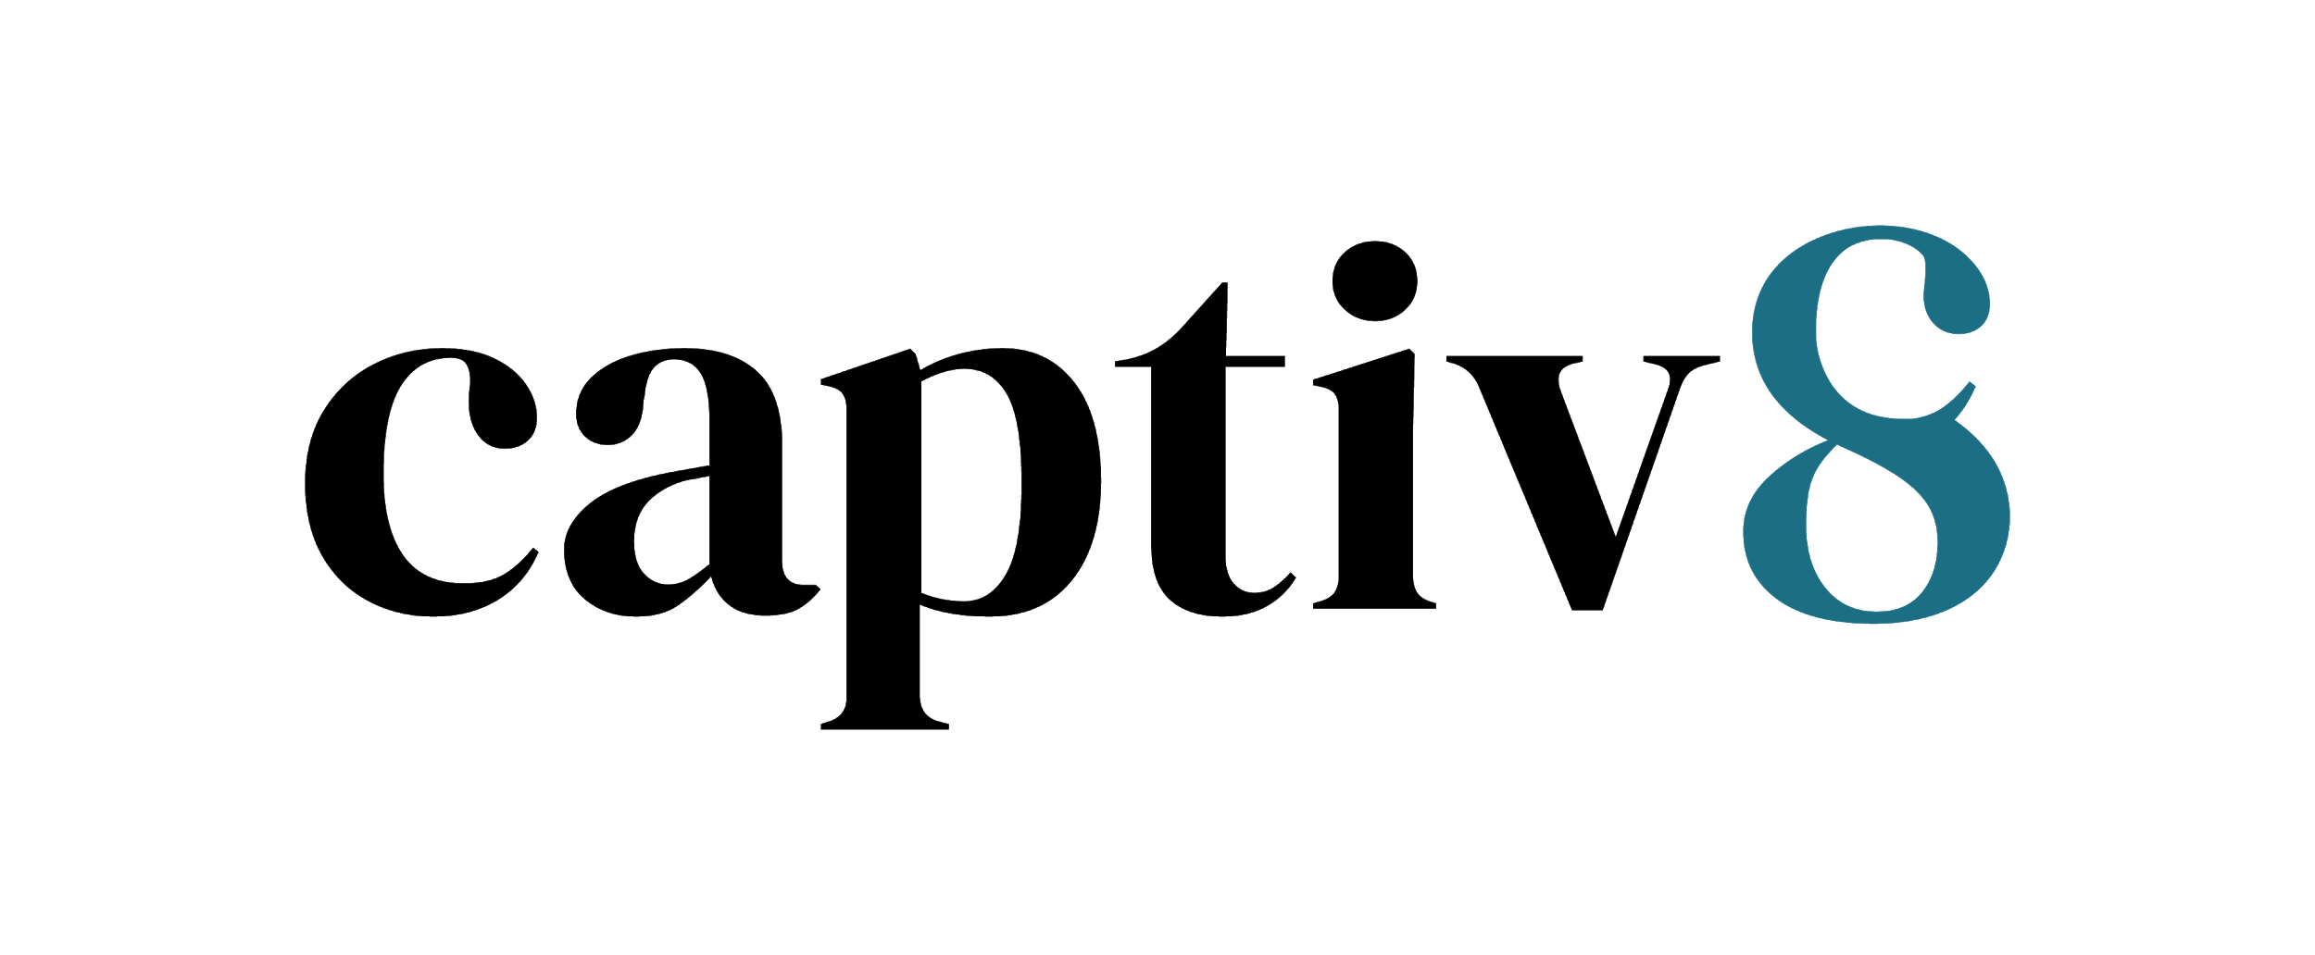

How We’ll Reach Qualtrics Audiences
Paid Media Approach
INTERESTS
RETARGETING
Professional Interests: Management, Tips, Technology, Professional Growth, etc.
Talent-Specific: Ryan Reynolds, Martha Stewart, Joanna Gaines, etc.
Competitors: SurveyMonkey, SalesForce, etc.
If applicable, retarget previous website visitors + social content engagers.
DEMOGRAPHICS
Male + Female
Ages 28+
Located in the US
PLATFORM
KPI + OPTIMIZATIONS
AD FORMATS
Facebook, Instagram and / or TikTok
Phase 1: Site Traffic (registrations)
Phase 2: Impressions (awareness)
In-feed, Videos, TikToks

Slide 16
Tips for an On-Site Event
Notes:
Sae

Slide 17
Items you should provide talent with
On-site Contact
Will a brand representative be on-site with the talent?
Provide Name & Phone Number
Call Time for Talent
What time does the talent need to arrive?
How long are talent expected to be on-site?
If overnight, will the brand be providing hotel accommodations?
How will talent get to the event location?
Will the brand be providing transportation?
Will the brand be reimbursing talent for transportation if they travel themselves?
Location for Talent to meet the onsite contact
Please provide address and parking details
How talent will secure pass/ticket/entry (if applicable)
Map of the venue (if applicable)
Will there be a production crew on site capturing content?
If no, what kind of equipment will be allowed for talent to bring?

Slide 18
Items you should provide talent with
Wardrobe Guidelines
What should the talent wear on-site?
Will the brand be providing wardrobe?
Will the brand be providing hair and makeup?
Is there anything to be avoided?
Confirm if talent must bring anything with them
Can talent bring a plus-one with them?
Provide talking points and key messaging for talent

Slide 19
Measurement
Notes:
Sae

Slide 20
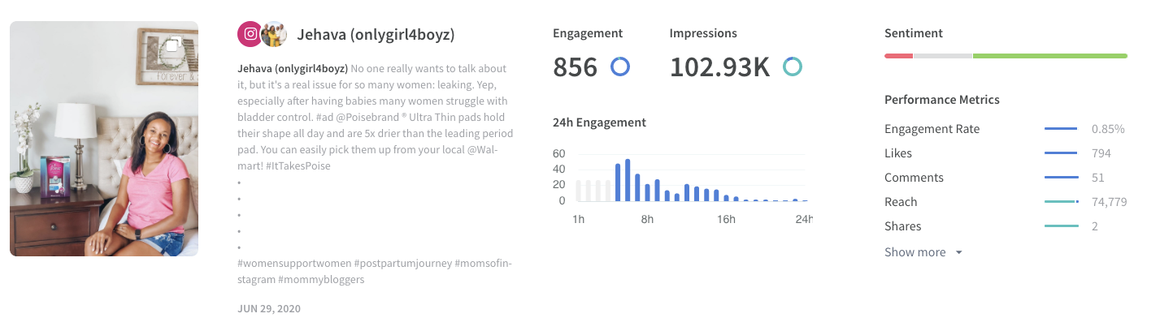
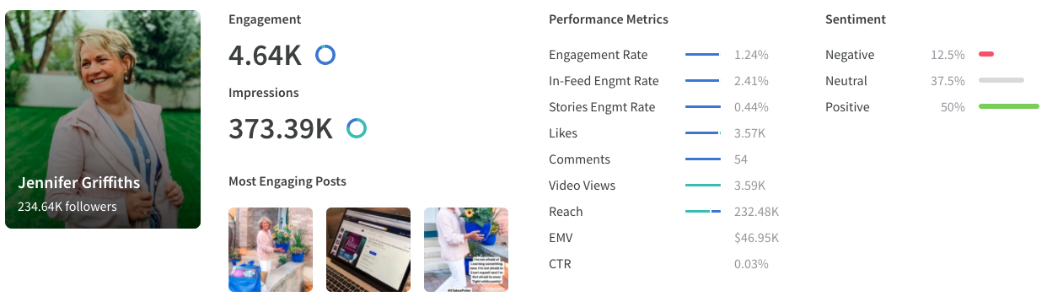
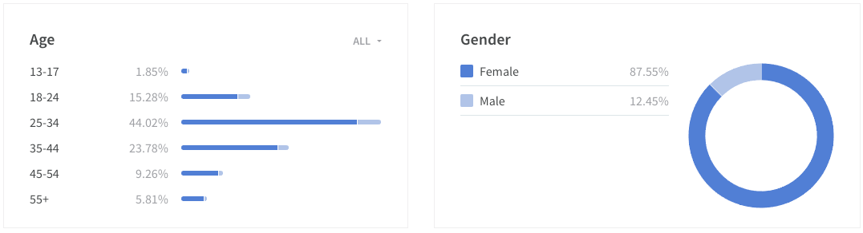
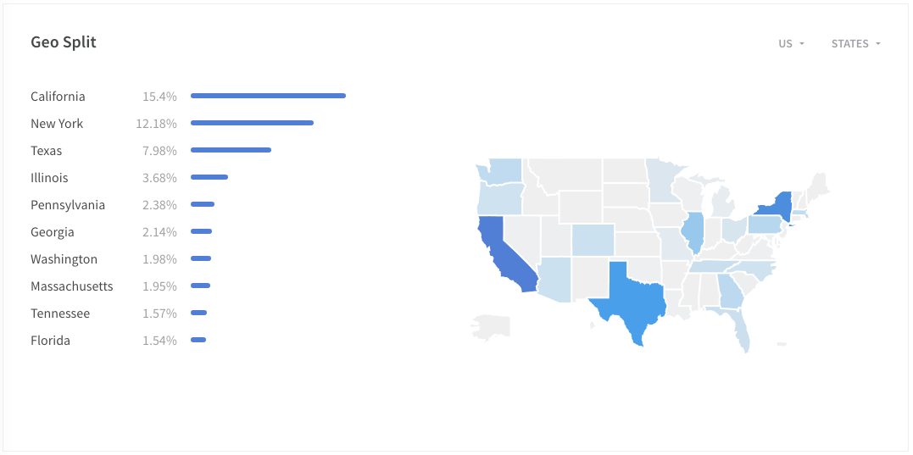
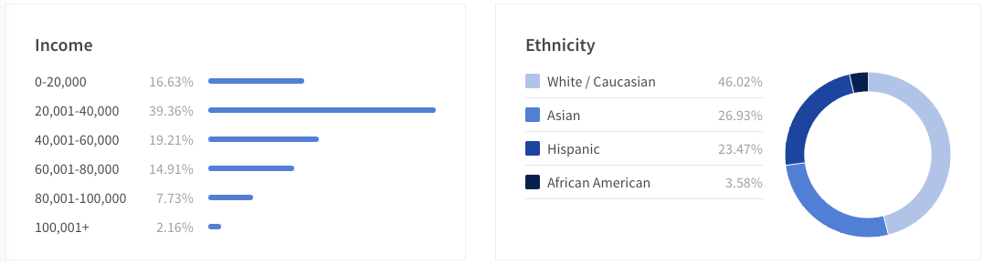
Transparent Reporting
Qualtrics + Captiv8
Our platform reports transparently on how posts perform, splitting out organic and paid. Giving you the whole story. Reporting can be broken out on a campaign level, post level + creator level.
Likes, Comments, Views, Shares
Audience Sentiment 24 Hour Post Engagement
Organic Post Impressions
Organic Reach
Post saves/bookmarks
Organic Clicks + CTR
Click Based Conversions
Organic Engaged Audience Demo
Organic Engaged Audience Geo

Slide 21
Thank You.
terrence@captiv8.io
www.Captiv8.io
This proposal contains proprietary information of Captiv8. Captiv8 retains all right, title, and interest in and to such proprietary information, and it is provided solely for the information and use of parties in evaluating the proposal. Such proprietary information may not be used, reproduced, or disclosed to any other parties for any other purpose without the prior express written consent of Captiv8. By accepting the delivery of this proposal, the company and individuals accepting such delivery agree to these terms.

